Slide 1
Predicting the Level of Stress using Mobile Phone Data
Saman Rahbar
Nathan Yang
Rifat Zahan

Slide 2
Motivation and Objective
Frequent and chronic stress are associated with immune disorder, depression and different types of chronic diseases.
Monitoring stress at work and studying the associated factors have become quite popular.
Massive use of smartphone has created a solid ground to study human behavior.
The objective of this study is to predict stress level among university students by using smartphone data.

Slide 3
Research Questions
What factors are significantly associated with stress level among university students?
What would be the best model to predict stress level with smartphone and survey data (e.g., transportation method used, time spent on campus, types of food purchased, involvement in physical activities, etc.)?

Slide 4
Operationalization
WiFi Data: Accuracies <= 50 m were considered to calculate dwell time on campus.
Response Rate: At least 5, 10, 12, 15 responses from each participants were considered for further analyses.

Slide 5
Operationalization: Continued…
Survey Data
Stress Score: Daily median stress scores (0-10) were considered for analysis.
Transportation Mode: Three major transportation groups:
Bus
Car/Carpool
Walk/Run
Exercise Types: Two categories:
Exercise/No exercise
People, who considered walk/run as exercise were eliminated from the study.
Physical activity, which happened 10 hours ago were not considered.
Food Choice: Two broad categories:
Fast Food
No Fast-Food

Slide 6
Key Background Results
Figure 1: Boxplot of stress scores among different weeks.
Figure 2: Boxplot of stress scores among different hours spent at school.

Slide 7
Key Background Results
Figure 3: Boxplot of stress scores among different transportation methods used to come to school.

Slide 8
Key Background Results
n = 76
n = 116
n = 563
n = 563
n = 57
n = 131
Figure 5: Boxplot of stress scores among different food groups.
Figure 4: Boxplot of stress scores among physical activity groups.

Slide 9
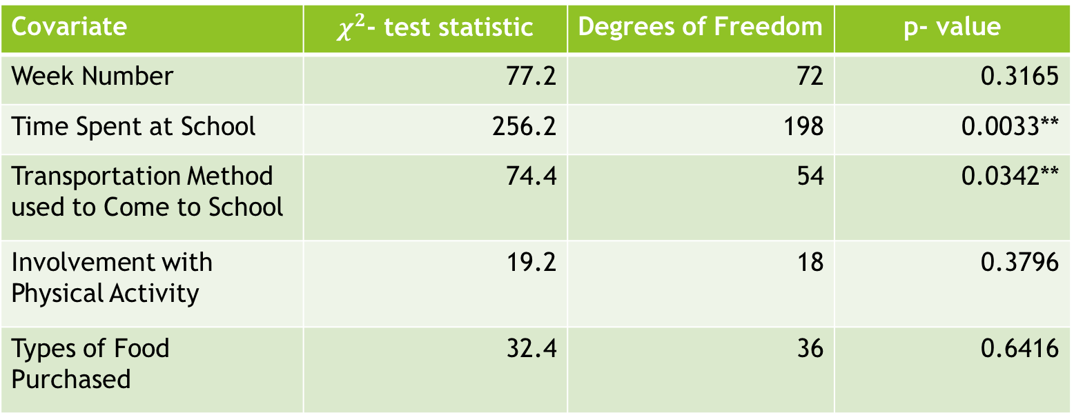
Operationalization Results
Total sample size, n = 751 from 86 participants
Covariate | $χ^{2}$- test statistic | Degrees of Freedom | p- value
Week Number | 77.2 | 72 | 0.3165
Time Spent at School | 256.2 | 198 | 0.0033**
Transportation Method used to Come to School | 74.4 | 54 | 0.0342**
Involvement with Physical Activity | 19.2 | 18 | 0.3796
Types of Food Purchased | 32.4 | 36 | 0.6416
Table 1: Pearson’s $χ^{2}$ test statistic to look for the association between stress and different variables.

Slide 10
Results: Final Model
Covariates | Odds Ratio (OR) | 95% Confidence Interval (CI) | p-value
Transportation Mode
Bus^{(Reference Cat.)} | - | - | -
Walk/Run | 0.68 | [0.49, 0.94] | <0.05
Car/Carpool | 0.84 | [0.58, 1.23] | >0.10
Time Spent at School
One Hour^{(Reference Cat.)} | - | - | -
Two Hours | 0.98 | [0.56, 1.72] | >0.10
Three Hours | 1.35 | [0.80, 2.30] | >0.10
Four Hours | 1.98 | [1.16, 3.40] | <0.05
Five Hours | 1.50 | [0.86, 2.61] | >0.10
Six Hours | 2.29 | [1.32, 3.98] | <0.01
Seven Hours | 3.68 | [1.88, 7.21] | <0.01
Eight Hours or More | 3.42 | [1.80, 6.24] | <0.01
Table 2: Summary results from Ordinal Logistic Regression Model (ordered stress score is the dependent variable).
Total sample size, n = 620 from 58 participants; at least 5 responses from each individuals

Slide 11
Discussion
Transportation method that were chosen to come to school and the amount of time spent on campus show significant association with stress level.
Stress level increases with hours spent on campus.
The study found that those, who come to school either by foot or by car were less stressed, compared to those, who came to school by bus.

Slide 12
Future Work
Model validation or diagnostic checking will be done.
Literature shows that involvement in physical activity are significantly associated with stress level. Different operationalize method should be used to look for such association.
Modern Machine Learning algorithm should be implemented to classify the stress level.
App usage data should be incorporated as possible covariate(s).

Slide 13
Conclusion
Mobile phone data exhibits that different types of commute and time spent at school have significant effect on stress level among university students.

Slide 14
Thank You

Slide 15
Week | Frequency
Week 6 | 157
Week 7 | 186
Week 8 | 130
Week 9 | 210
Week 10 | 68

Slide 16
Fast Food Consumption | Frequency
Yes | 72
No | 116
NA’s | 563

Slide 17
Hours Spent at School | Frequency
1: Less than an hour | 90
2: One Hour | 88
3: Two Hours | 104
4: Three Hours | 112
5: Four Hours | 97
6: Five Hours | 80
7: Six Hours | 83
8: Seven Hours | 41
9: Eight Hours or More | 56

Slide 18
Quartiles | Stress Score
0% | 0.0
25% | 1.0
50% | 3.0
75% | 5.5
100% | 10.0

